Slide 1


Slide 2


Slide 3
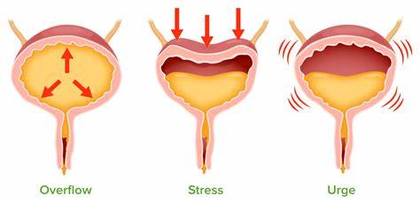

Slide 4
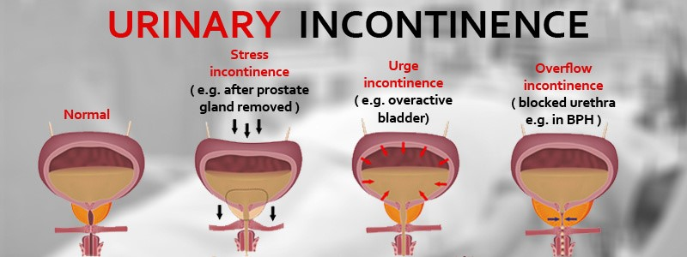
URINARY INCONTINENCE
Prepared by:
Bandana Tiwari
Roll no: 6
BNS 2nd year

Slide 5
GENERAL OBJECTIVES
At the end of the classroom session, BNS 1st year students will be able to explain about urinary incontinence and urinary retention.

Slide 6
SPECIFIC OBJECTIVES
At the end of this teaching session, the BNS 1st year students will be able to :
define urinary incontinence
enlist the types of urinary incontinence
list the causes of urinary incontinence
state the signs and symptoms of urinary incontinence
enlist the diagnostic investigation of urinary incontinence
explain the treatment procedure of urinary incontinence

Slide 7
Cont..
explain the nursing management of urinary incontinence
explain the prevention of urinary incontinence
define urinary retention
state the types of urinary retention
list the causes of urinary retention
state the signs and symptoms of urinary retention
enlist the diagnostic investigation of urinary retention
explain the treatment procedure of urinary retention
explain the nursing management of urinary retention
List the complication of urinary retention

Slide 8

URINARY INCONTINENCE

Slide 9
INTRODUCTION
Urinary incontinence is defined as an inability to hold or control urine, leading to leakage of urine.
It is also called involuntary leakage of urine or it is the unintentional passing of urine .
Urinary incontinence affects many people of all ages but particularly common among the elderly.

Slide 10
Cont..
Incidence
It is estimated that at least 10% of people over 65 years have urine incontinence , among them 10% in community people and 30% in nursing home residents.

Slide 11
TYPES
Stress incontinence
Urge incontinence
Overflow incontinence
4) Functional incontinence

Slide 12
CAUSES
Urinary tract infection
Limited mobility
Obesity
Poorly controlled diabetes

Slide 13
Cont..
e) Neurological conditions such as stroke, parkinson’s disease
f) Menopause
g) Weak pelvic floor muscle in both men and women
h) Respiratory aliments with chronic coughing

Slide 14
SIGN AND SYMPTOMS
Sensory sign:
Odor of urine or feces in the room
Soiling of undergarments or bed linens
Irritation of perineal area

Slide 15
Cont..
Emotional sign :
Anger
Decline in social activity
Desire for attention

Slide 16
DIAGNOSTIC EVALUATION
History taking
Physical examination
Urine analysis
Blood test

Slide 17
Cont..
Post void residual
Urodynamic testing
Cystogram
Cystoscopy

Slide 18
TREATMENT
Medical management :
Anticholinergic or antispasmodic drugs
Antibiotics

Slide 19
Cont..
2. Surgical management:
Artificial urinary sphincter
Sling procedures
Bladder neck suspension procedure

Slide 20
Cont..
Retropubic colposuspension
Bladder augmentation

Slide 21
NURSING MANAGEMENT
Assessment
Assess for frequency of incontinence .
Asses for characteristics of urine.
Observe urine output.

Slide 22
Cont..
Assess the emotional status of patient .
Assess for any voiding symptoms .

Slide 23
NURSING DIAGNOSIS
Altered urinary incontinence related to loss of voluntary control of urinary elimination.
Altered skin integrity related to urinary incontinence .
Anxiety related to misinformation and fear of complication .

Slide 24
Cont..
Knowledge deficient related to disease management and its prognosis.
Risk for situational low self- esteem related to restriction in social activities, depression and dependence on caregivers.

Slide 25
NURSING INTERVENTION
Achieving optimal urinary control:
Assess the clients pattern of fluid intake and urination.
Allow sufficient time for voiding.
Provide adequate fluid intake .

Slide 26
Cont..
Avoid indwelling catheter whenever possible to avoid risk of UTI.
Record patient input and output.

Slide 27
2. Maintaining / improving skin integrity:
Inspect genitoperineal area daily.
Position change 2 hourly to prevent pressure sore in bedridden patients.
Encourage use of clothing that can be easily and quickly removed.

Slide 28
Cont..
Use of moisture- barrier ointments .
Change undergarments daily.

Slide 29
3. Reducing anxiety:
Inform patient that urinary incontinence is not shameful, it is treatable and manageable.
Encourage patient to ventilate their feelings.
Provide emotional support and assist in activities.

Slide 30
Cont..
Provide information regarding all available methods of managing urinary incontinence.

Slide 31
4. Promoting understanding about disease condition:
Inform patient that urinary incontinence itself is not a disease but a symptom.
Provide information on odor control.
Encourage use of prescribed medicine.
Familiarize patient with potential risk of skin breakdown.

Slide 32
5. Maintaining self- esteem and socialize with other:
Provide emotional support to the patient.
Providing positive reinforcement.
Instruct the family members so that they may assist in maintaining self-esteem of the patient.

Slide 33
Cont..
Encourage for actively participation in social activities as well as daily self care activities.

Slide 34
PREVENTION
Dietary modification
Maintaining a healthy weight
Avoid tobacco
Control of underlying disease such as : hypertension , diabetes

Slide 35
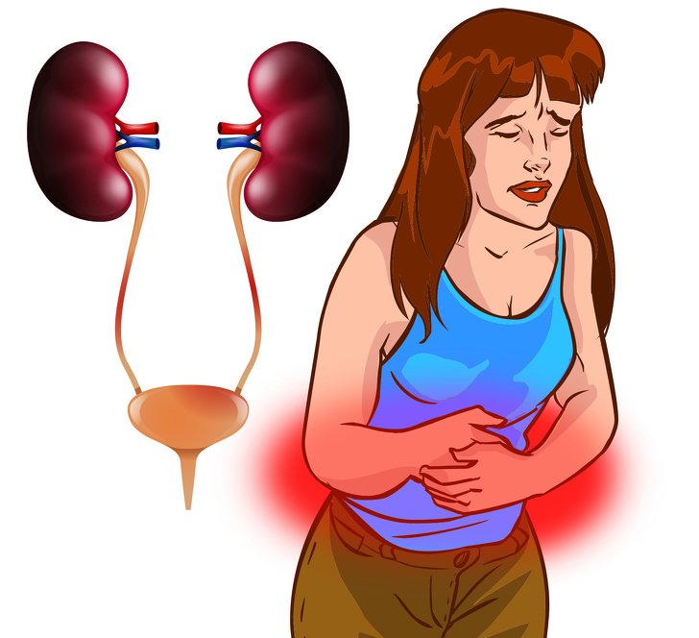

Slide 36
URINARY RETENTION
Urinary retention is defined as the inability to completely or partially empty the bladder .
In other words, urinary retention is incomplete emptying of the bladder or cessation of urination; it may be acute or chronic .

Slide 37
Cont..
It is most common in men in their 50s and 60s because of prostate enlargement .

Slide 38
TYPES
Obstructive
Non- obstructive

Slide 39
CAUSES
Obstructive :
Kidney stone
Non obstructive:
Enlarge prostate in men
2. Pelvic injury or trauma

Slide 40
Cont..
3. Stroke
4. Drugs
5. Cancer
6.Accidents that injure the brain and spinal cord

Slide 41
SIGN AND SYMPTOMS
Difficulty starting to urinate
Difficulty fully emptying the bladder
Weak dribble or stream of urine
Loss of small amount of urine during the day

Slide 42
Cont..
Inability to feel when bladder is full
Increased abdominal pressure
Lack of urge to urinate
Strained efforts to push urine out of the bladder

Slide 43
DIAGNOSTIC EVALUATION
History taking
Physical examination
Urinalysis
cystoscopy

Slide 44
Cont..
Blood test
Ultrasonography

Slide 45
TREATMENT
Medical management :
Bladder drainage
Urethral dilation
Urethral stents
d. Prostate medications (finasteride )

Slide 46
Surgical management
Prostate surgery
Cystocele or rectocele repair
Tumor or cancer surgery

Slide 47

NURSING MANAGEMENT

Slide 48
COMPLICATION
UTI
Bladder damage
Kidney damage

Slide 49


Slide 50


Slide 51
POST TEST
Fill in the blanks (1*1=1)
1. Obstructive urinary retention is caused by ….
Pelvic injury
Kidney stone
Stroke
Drugs

Slide 52
Cont..
True or false (1*1=1)
1. Urinary incontinence is treated by anticholinergic drugs.
(True)
2. Urinary tract infection is not a complication of urinary retention .
( False)

Slide 53
ASSIGNMENT
What do you understand about urinary incontinence ? Write its nursing management .
2. Write short note on:
Urinary retention

Slide 54
PLAN FOR NEXT CLASS
We will discuss about urinary tract infection and chronic kidney disease.

Slide 55
REFERENCES
K.C, T, & Rai, B, (2019). A Textbook of Geriatric Nursing. (3rd ed). Heritage publisher and distributors.
Subbha.K,H & Subedi, P,S,(2019). A Textbook of Geriatric Nursing. (1st ed). National book centre.
Baral.R, Essential of Geriatric Nursing. Makalu publication.
Pradhan.M,K & Roka, A,T.(2015). Gerontological Nursing for BN/BSN Students. (1st ed) Vidyarthi publication.
Timalsina,R, (2020). Comprehensive Textbook of geriatric Nursing (3rd ed). Samiksha publication.

Slide 56


